Slide 1

Client-side Exploitation
Name: David Omasete
Occupation: SOC Analyst
Email: David.Omasete@Strathmore.edu

Slide 2
Course outline
TOPIC | Deliverables
Introduction to Client-side exploitation | Introductions & Course Overview of Client-side exploitations learning components
Social Engineering | Social Engineering Types of Social Engineering Behaviors Vulnerable to attacks Countermeasures for SE Policies and procedures
MS Office Macros & Outlook Macros | Description of MS Office Macros Attack Macros Attack tools & Methods Detecting & countering Macros attacks
Watering Holes & Targeting Mobile Devices | Waterhole attacks Techniques and countermeasures What is Mobile Targeting Types of mobile targeting Benefits

Slide 3

Social Engineering

Slide 4
1. Social Engineering 2. Types of Social Engineering 3. Behaviors Vulnerable to attacks 4. Countermeasures for Social Engineering 5. Policies and procedures 6. Identity Theft 7. Countermeasures for Identity Theft
Learning Objectives

Slide 5
Social Engineering is the human side of breaking into a corporate network it is the Tactic or trick of gaining sensitive information by exploiting the basic human nature such as Trust, Fear, Desire The attempt is to gain information such as Sensitive information, Authorization details, Access details
What is Social Engineering?

Slide 6
What is Social Engineering?
An employee may unwittingly give away Key information in an email or by answering questions over the phone with someone they don’t know.
They can talk with coworkers about a project at a local pub.

Slide 7
Social Engineering Techniques
There’s no single Security mechanism that can protect from Social Engineering Techniques used by attackers.

Slide 8
Types of Social Engineering
Human-Based Social Engineering
Gathers information by interaction
Attacks of this category exploits fear, trust and helping nature of people

Slide 9
Human-Based Social Engineering
Posing as a legitimate end user
Posing as an important user
Posing as a Technical support
Eavesdropping
Shoulder surfing
Dumpster diving

Slide 10
Tailgating
An authorized person may be unaware
of providing an unauthorized person access
to a secure area.
An unauthorized person, wearing a fake
ID badge, enters a secure area by closely
following an unauthorized through a door
requiring key access

Slide 11
Piggybacking
An authorized person provides access
to an unauthorized person by keeping a
secure door open
“I forgot my key at home. Please hold the
door ”

Slide 12
Reverse Social Engineering
This is when the attacker creates a
persona that appears to be in a position
of authority so that employees will ask him
for information, rather than the other
way round
Involves sabotage, marketing, providing
support
Notes:
* Movies like The Italian job and catch me if you can

Slide 13
Computer-based Social Engineering
Carried out with the help of computers
It can be divided into:
Mail/IM attachments
Pop-up windows
Websites/ sweepstakes
Spam mail

Slide 14
Pop-Up windows
Windows that suddenly pops-up, while
surfing the internet and asks for users’
Information to login or sign in

Slide 15
Hoaxes and Chain letters
Hoax letters are emails that issue warnings
To users on new virus, Trojans or worms
that may harm the user’s system.
Chain letters are emails that offer free
gifts such as money and software on
condition that the user sends to a said
number of persons

Slide 16
Instant Chat messenger
Gathering of personal information by
Chatting with a selected online user to
Attempt to get information such as birth
Dates and maiden names
Acquired data is later used for cracking
The user’s accounts

Slide 17
Spam Email
Email sent to many recipients without
prior permission intended for commercial
purposes
Irrelevant, unwanted and unsolicited
email to collect financial information,
social security numbers and network
information

Slide 18
Phishing Emails
An illegitimate email falsely claiming to
be from a legitimate site attempts to
acquire user’s personal or account
information
Lures online users with statements such
As Verify your account, update your
Infromation and you account will be
closed or suspended

Slide 19
Insider Attack
If a competitor wants to cause damage
to your organization, steal secret, or put
you out of business, they just need to find
a job opening, prepare a someone to pass,
the interview, have that person hired and
They have access.

Slide 20
Insider Attack Cont’
60% of attacks come from behind the
Firewall and it is difficult to prevent
It can only take one disgruntled
employee wanting revenge to sell critical
information.

Slide 21
Preventing Insider Attacks
There is no single solution for an insider
threat

Slide 22
Recommendations
Separation of duties
Rotation of Duties
Least Privilege
Controlled access
Logging and auditing
Legal Policies
Archive critical data

Slide 23
Common Targets of social Engineering
Receptionist and help desk personnel
Technical support executives
Vendors of target organization
System administrators and users

Slide 24
Threats and Defenses
Major Attack Vectors used by hackers
include:
Online
Telephone
Personal approaches
Reverse social engineering

Slide 25
Personal Approach Threats
Intimidation
Persuasion
Ingratiation
Assistance
Notes:
* Ingratiating is a psychological technique in which an individual attempts to influence another person by becoming more likeable to their target.

Slide 26
Defenses Against SE Threats
Steps are necessary to defend against SE
threats
Develop a security management
framework
Undertake risk management assessments
Implement SE defenses within your
security policy

Slide 27
Risk Assessment
You need to assess the level of risk that an
attack possesses towards your company for
Deploying suitable measures

Slide 28
Risk Categories
Confidential information
Business Credibility
Business Availability
Resources
Money

Slide 29
Factors That make Companies Vulnerable to Attacks
Insufficient security training & awareness
Several organization units
Lack of appropriate security policies
Easy access of information eg. Email IDs
& extension numbers for employees

Slide 30
Why is SE Effective?
Security policies are as strong as its weakest
link and humans are then most susceptible
factor
Difficult to detect SE attempts
No method to ensure complete security
from SE attacks

Slide 31
Warning signs of an Attack
Attacker May:
Show inability to give a valid callback number
Make informal requests
Show haste
Unusual compliment or praise
Show discomfort when questioned
Threaten of dire consequences if information is not
provided

Slide 32
Impact on the Organization
Economic losses
Damage of goodwill
Loss of privacy
Dangers of terrorism
Lawsuits and arbitrations
Temporary or permanent closure

Slide 33
Countermeasures
Training
Password policy
Operational guidelines
Physical security policies
Classification of information
Access privileges
Background check of employees and proper termination process
Proper incidence response team
Notes:
An efficient training program should consist of all security policies and methods to increase awareness on social engineering
Periodic password change, avoid guessable passwords, account blocking after failed attempts, length and complexity of passwords, secrecy of passwords
Ensure security of sensitive information and authorized use of resources

Slide 34
Identity theft
Occurs when someone steals your name
and other personal information for
fraudulent purposes.

Slide 35
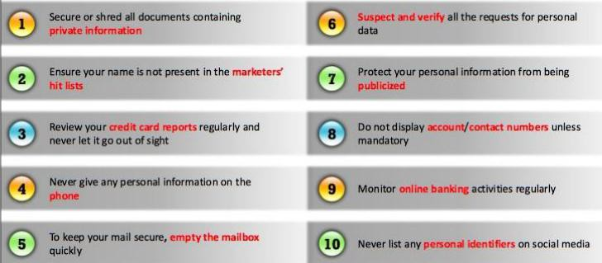
Identity Theft Countermeasures

Slide 36
Exercise
How to perform identity theft
Impact of identity theft
How to mitigate identity theft

Slide 37
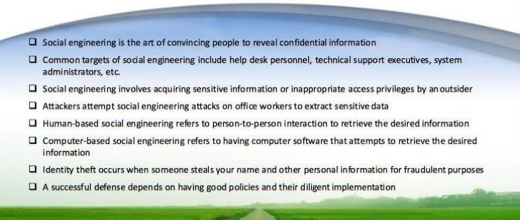
Summary

Slide 38


Thank you!
Any Questions?

Slide 39
SOCIAL ENGINEERING LABS
Kindly follow this link to find the Labs for social engineering
https://daveeargle.com/security-assignments/labs/lab_social_engineering.html#part-1-msfvenom-with-fake-adobeupdateexe

